Slide 1
CSC-430(001) / 530 : DATABASE MANAGEMENT SYSTEMS / Database Theory
Winter 2023
Final Project Presentation - Instruction Guide
And
Example

Slide 2
Overview: A Relational Database Project
APPLICATION DOMAIN
1
PROBLEM STATEMENT
2
3
ENTITY RELATIONSHIP MODEL
Data Dictionary
CONCEPTUAL VIEW
4
Derive Integrity Checks
Ensure Normalization
PHYSICAL MODEL
Create Triggers
Final Database Schema

Slide 3
Project Proposals
What is expected in Final Report Submission?
A consolidated deck of slides that captures the following:
Provide a clear description of the Application Domain (2-3 slides)
Problem Statement (1 slide)
The ER from the proposal, and Updated ER. (1-2 slides)
Enumerate the integrity constraints (1-2 slides)
Enumerate and describe the different constraints enforced (1-2 slides)
Do not forget to include CASCADES for Anomalous DDL Queries (in demo)
For each relation in the DB, explain which Normal Form was achieved with tables in your relationship (2 slides)
Explain one trigger and one view built in the application ?
In both (2-slides) and in demo
Acknowledgement of Team by roles played by each member.
In both (1-slide) and in demo

Slide 4
What you will submit
One Submission per group; to include:
The Final PPT presentation.
A 5-minute recording of project (DEMO)
DEMO will include:
explaining code.
Examples for Integrity constrains (with DDL anomalies)
Examples of Triggers and Views.
A clear demarcation of roles.
Final Date of Submission: Feb 23rd, 2023 (@5:00 pm).
NO EXTENSIONS WILL BE POSSIBLE

Slide 5
DBMS Final Project
EXAMPLE:

Slide 6
Application Domain - Area of Application
Purpose: Make it easier for teachers to conduct Evaluations on Students within a school
Our database will…
Keep track of every student in a class along with unique information about them, including their answers to an evaluation completed multiple times throughout the year
Come with a user-friendly web-based interface for accessing and changing information
Make it easier for teachers to conduct the evaluations and compare/analyze evaluation results by consolidating all the data in one place

Slide 7
Application Domain - Challenges
This project requires a database because…
The high number of relationships and the complexity of those relationships between the entities
Multiple users (teachers, students)
Centralized control of data
Notes:
- each teacher has several classes and many students
- each student is a part of several classes
- each class has many students
Students are limited to only their own records, while teachers have access to all student information
All the information is stored in one location, making it easier to access and compare/analyze

Slide 8
Problem Statement
Entities
Student (SID, SName, SEmail, Password, SBirthday)
Teacher(TID, TName, TEmail, Password)
Class (CID, CName)
Evaluation (EID, Title, Date)
Question(QID, QText, Correct, Choice1, Choice2, Choice3, Choice4)
Relationships
Enroll (SID, CID)
Teach (TID, CID)
Evaluate_Class (EID, CID)
Eval_Question (EID, QID)
Ques_Respond (SID, QID, EID, Response)
Taken (SID, EID)

Slide 9
Problem Statement
Entity Relationship Constraints
A class will have a single teacher but a teacher can teach multiple classes
A student can be enrolled in many classes and a class can have many student enrolled in it
A class can have zero or more evaluations and an evaluation can belong to multiple classes
A student can have 0 or 1 response for each question
A student can only take an evaluation once

Slide 10
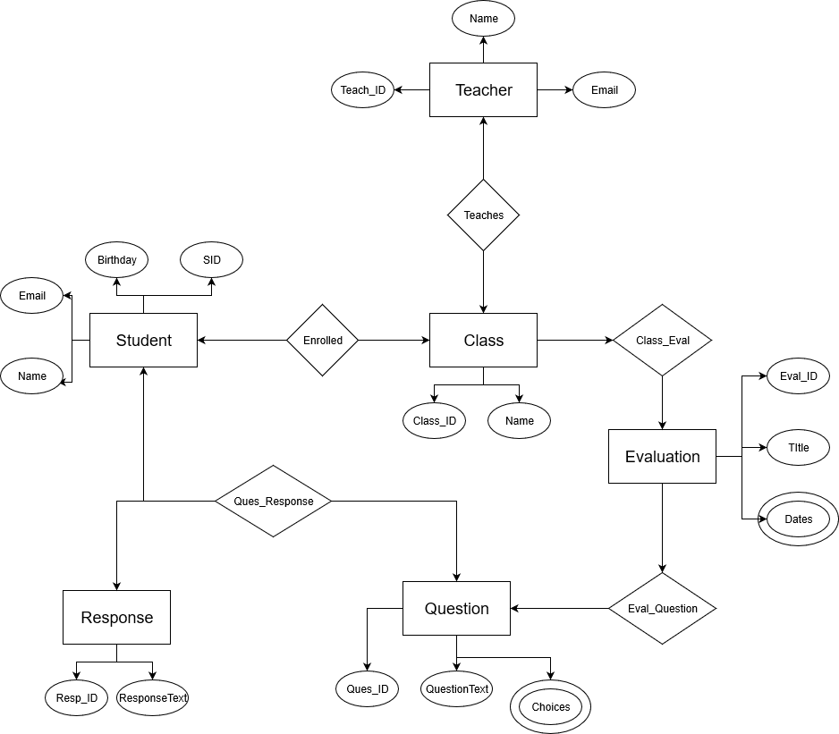
Old E/R Model

Slide 11
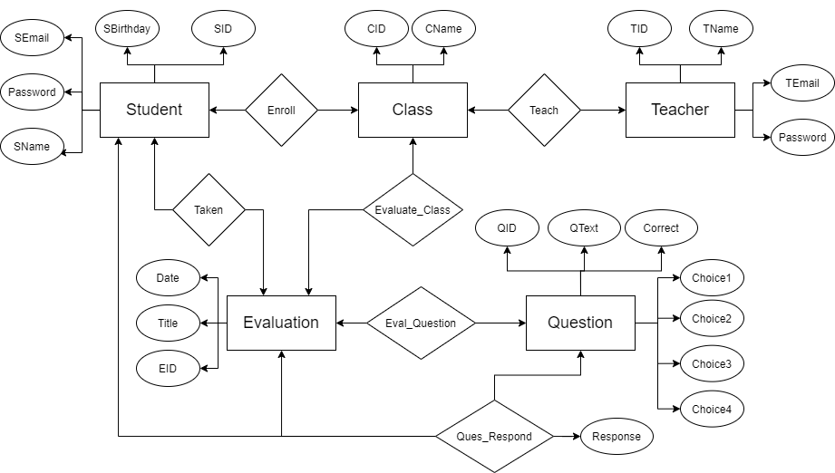
New E/R Model

Slide 12
Integrity Constraints
Primary Keys are NOT NULL and UNIQUE
Relationships: PRIMARY KEY (*ID, *ID) (*ID is FOREIGN KEY referencing entity)

Slide 13
BCNF - Old Model
Our Violations:
1NF: multivalued attributes
Question.Choices
Evaluation.Dates
Our Solutions:
Question.Choice1, Question.Choice2, Question.Choice3, Question.Choice4
New Evaluation entity for each date

Slide 14
BCNF - New Model
Functional Dependencies: {SID → SName, SEmail, Password, SBirthday} {CID → CName} {TID → TName, TEmail, Password} {QID → QText, Correct, Choice1, Choice2, Choice3, Choice4} {EID → Title, Date} {SID, QID, EID → Response}
1NF: no multivalued attributes ✅
2NF: no partial dependencies ✅
3NF: no transitivity ✅
BCNF: every determinant is a candidate key ✅

Slide 15
Triggers
Deletes all Questions and responses associated with an Evaluation if the Evaluation is deleted
DELIMITER $$
CREATE TRIGGER DeleteEval
BEFORE DELETE ON Evaluation
FOR EACH ROW
BEGIN
DELETE FROM Taken WHERE EID=OLD.EID;
DELETE FROM Evaluate_Class WHERE EID=OLD.EID;
DELETE FROM Eval_Question WHERE EID=OLD.EID;
DELETE FROM Ques_Respond WHERE EID=OLD.EID;
END$$
DELIMITER ;

Slide 16
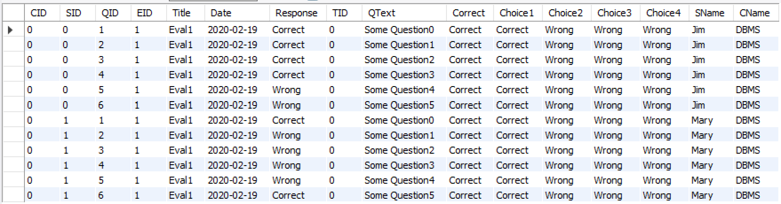
Views
AllResults: Used to return all responses associated with a specific teacher
Can then easily be filtered by Question, Student, or Evaluation
SELECT * FROM AllResults;

Slide 17
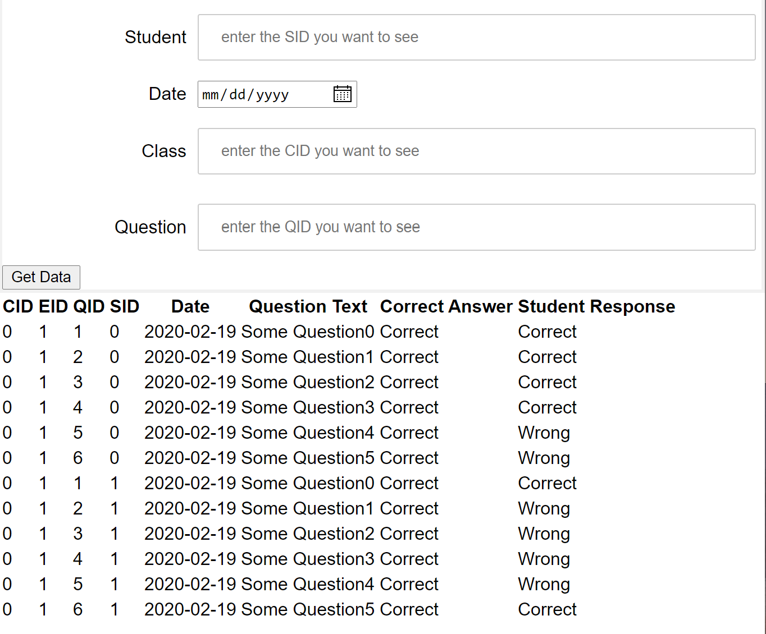
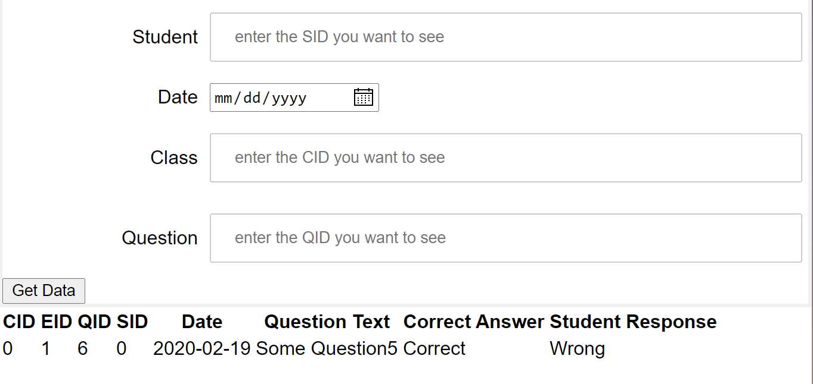
Views
Can limit what responses are shown using the frontend website

Slide 18
Acknowledgements
* Both team members contributed to every part of the project, these acknowledgments just represent where the majority of the work was completed
XXXX | XXXXXX
HTML/Front End Foundational SQL database | Connecting database to front end with Python Hosting local server

